Slide 1
Relative Spectral Analysis-RASTA
By Davies Odu & Shengxin Qian

Slide 2
Introduction
RASTA algorithm use auditory masking principle in reducing the perception of noise.
This method uses frequency domain masking to maximize noise reduction while minimizing speech distortion
Masking threshold is the spectral level (determined from the speech spectrum) below which non-speech components are masked by speech components in frequency.
Masking threshold for complex signals is determined based on known information about input signals

Slide 3
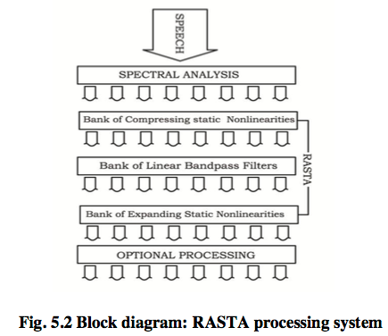
Algorithm
Compute the short time power spectrum of windowed signal.
Transform spectral amplitude through a compressing static nonlinear transformation.
Filter the time trajectory of each transformed spectral component.
Transform the filtered speech representation through expanding static nonlinear transformation.
Perform the overlap add synthesis and reconstruct the signal.

Slide 4
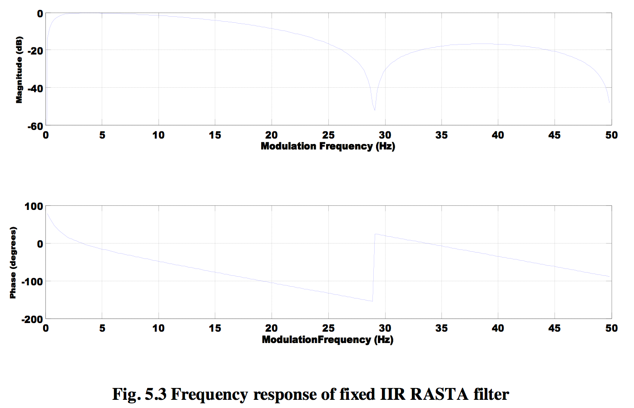
One RASTA filter example
The filter is designed with lower cut-off frequency of 0.26Hz. The filter slope decline 6dB/octave from 12.8Hz with sharp zeroes at 28.9Hz and at 50Hz.
The low-pass filtering helps to smooth some of the fast frame-to-frame spectral changes present in the short-term spectral estimate due to analysis artifacts.
The high-pass portion of the equivalent band pass filter is expected to alleviate the effect of convolutional noise introduced in the channel.

Slide 5
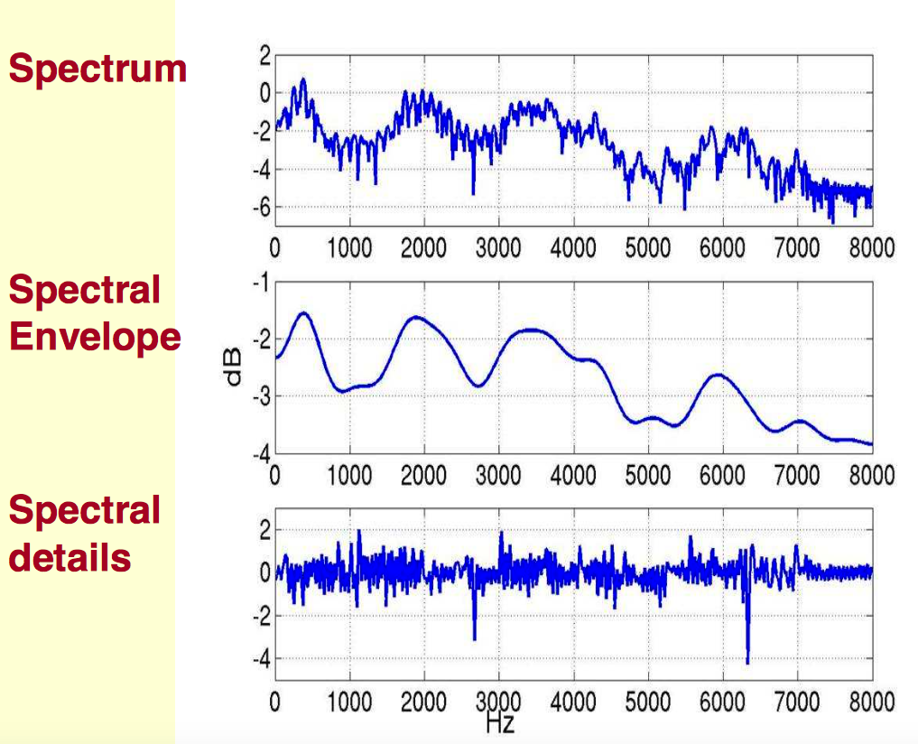
Intuition
For a wide range of frequency bands, the modulation spectrum of speech exhibits a maximum at about 4Hz, the average syllabic rate. RASTA filter suppresses the spectral components that changes more slowly than this frequency.
The RASTA filter suppresses high modulation frequencies to account for the human’s preference for signal change at a 4Hz rate. Disturbances such as additive noise may have different modulation spectrum properties than speech and often have modulation frequency components outside the speech range.

Slide 6
Comparison with other method
Auditory masking VS Classical spectral subtraction approaches:
Auditory based algorithm like RASTA outperforms other subtractive type residual noise suppression algorithms with respect to human perception with less distortion.

Slide 7
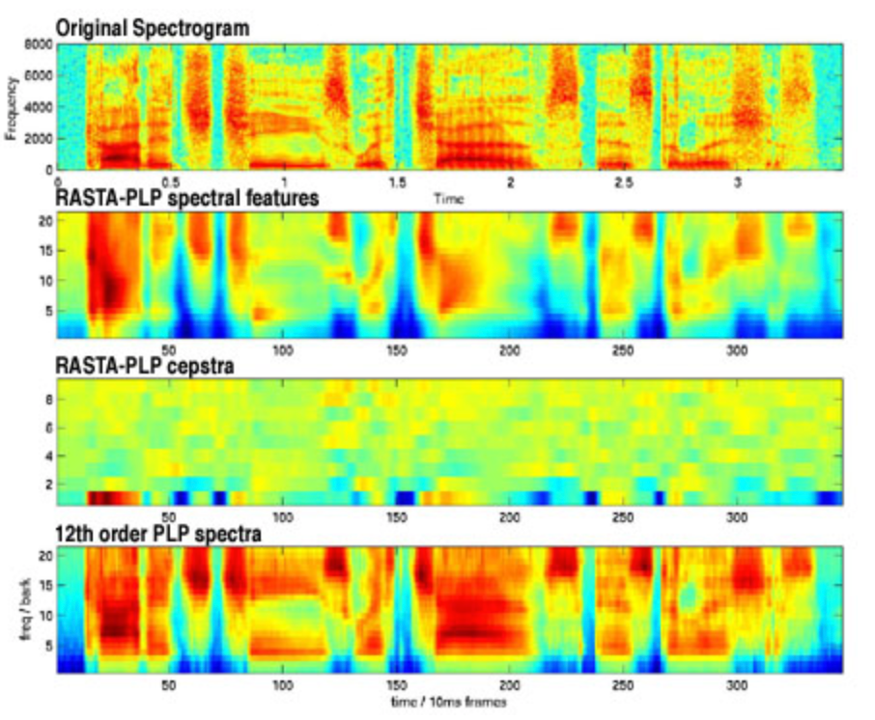
Demo
Notice the auditory warping of the frequency axis to give more space to low frequencies and the way that RASTA filtering emphasizes the onsets of static sounds like vowels.
Notice the greater level of temporal detail compared to the RASTA-filtered version. There is also greater spectral detail because our PLP model order is larger than the default of 8

